Slide 1
A core Course on Modeling
Introduction to Modeling
0LAB0 0LBB0 0LCB0 0LDB0
c.w.a.m.v.overveld@tue.nl
v.a.j.borghuis@tue.nl
S.7

Slide 2
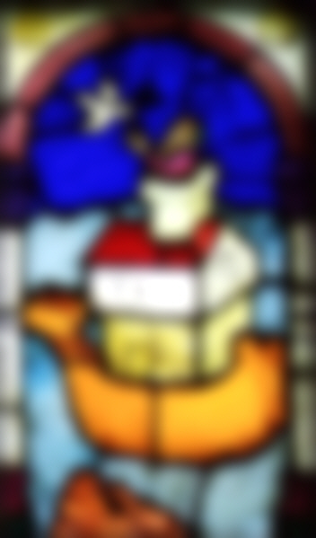
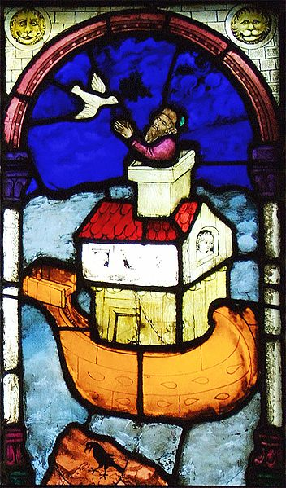
Segmentation:
partitioning the world into meaningful units
2
http://commons.wikimedia.org/wiki/File:Ulm-Muenster-BessererKapelleFenster-ArcheNoah.jpg
Notes:
2
In the beginning, the world was vague, unarticulated and blurred. There was no difference between light and dark, this and that, one and the other.
To see things as separate entities, we need to tell them apart. This is what the stain glass window maker does when he chooses his colourful pieces of glass. One piece will be the roof, an other will be a wave, a beard, a dove. These chips of glass are segments, meaningful parts, used to tell a story about a world that is worth while to tell stories about.

Slide 3
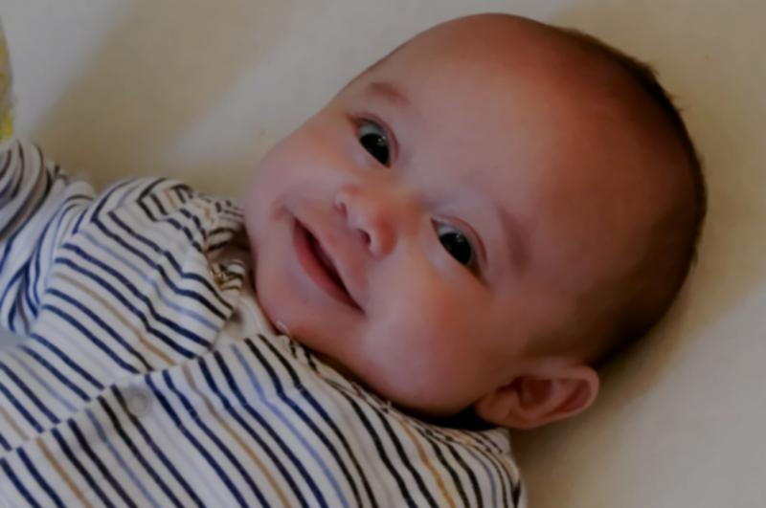
Segmentation:
a natural tendency of the human brain
3
http://commons.wikimedia.org/wiki/File:Baby_Boy_Oliver.jpg
Notes:
3
Segmentation is the skill of the window maker. He honed his crafts in many years of practice, but even a newborn baby partitions the world into meaningful segments. There are no speach, not yet, but just look at the eyes of a healthy child: within a few weeks after entering the world it will gaze at things, one thing at a time: its mother, its own hand, a toy, a milk bottle.

Slide 4
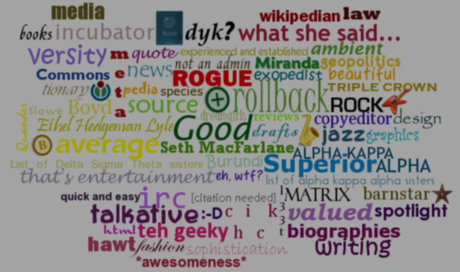
Words:
the brain’s way to segment the world
to form and share thoughts about the world
to reason about the world
to shape the world
4
http://commons.wikimedia.org/wiki/File:Bubbledemiranda.png
Notes:
4
When the baby brain develops, it will soon acquire a magical competence. It starts to make sense of the sounds in its environment. It recognizes those sounds that we call speach and learns to distinguish them from the wind, a squicking door or the singing of birds. Even more miraculously: it cracks the code, hidden within speach sounds. Segments of sound that occur repeatedly are recognized and remembered, soon they will be associated to things. The sound ‘mommy’ becomes tightly attached to the entity that feeds and caresses, ‘ball’ to the colourfull rolling entity, and so on. The brains learns to map the perceived segments in the world to organized, abstract portions of sound. Portions of organized speech sound we call words.

Slide 5
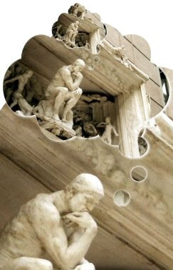
words refer to:
existing things
conceived things
http://commons.wikimedia.org/wiki/File:T%C3%A6nkeren_t%C3%A6nker_t%C3%A6nkeren-besk%C3%A5ret.jpg
Notes:
5
Perhaps even more astonishingly: the mapping between entities in the world to words also works in the opposite direction. A hungry toddler, craving for candy will use the word ‘candy’, perhaps stressing his point by rubbing his tummy, to make his desires known to his mother. But there is no candy to be seen: the word could refer to a historical situation (there was candy just a minute ago), to a future situation (there will be candy soon), or, more probably, to the pleasant but imaginative circumstance of candy being present. Words can be used to refer to existing things, as well as to non-existing things.

Slide 6
words refer to:
existing entities
conceived entities
←in modeled system
←in model: concepts
Notes:
6
Existing entities are found in the real world; that is the system we are modeling. The entities in our model are conceived, that is: they originate in the imagination of the modeler. From now one we will only deal with concepts, that is: conceived entities.
Concepts can be more extensive than mere words: they can be noun phrases (e.g., the ‘fiddler on the roof’).
Concept:
mentally constructed with a purpose
is named and (hopefully) explicitly defined
carries information
Entity:
‘real’ thing:
when we talk (think?) about it, it is a concept
we cannot inter-subjectively know anything from ‘real things’

Slide 7
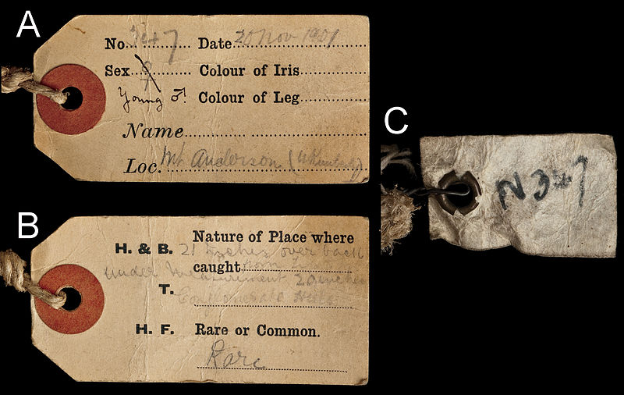
property:
informs
about the concept it belongs to
7
http://commons.wikimedia.org/wiki/File:Field_labels_attached_to_the_skin_of_BMNH_1939.3315_-_ZooKeys-255-103-g007.jpeg
Notes:
7
Property literally means: ‘possesions’

Slide 8
property:
has a name
has a set of values: the type.
names: eg. ‘color’, ‘size’, ‘use’;
types: eg. colors, numbers, activities;
values: eg. {red}, {15 … 18} cm, {drinking coffee, drinking tea}
Notes:
8
additional explanation:
units as additions to a set of numerical values
set notations:
singleton,
range
enumeration
otherwise (e.g., unions, intersections, ….) – does not occur in these lectures

Slide 9
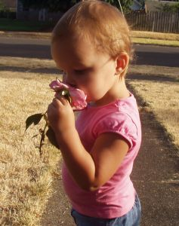
property ↔ value
question ↔ answer
test ↔ result
measurement ↔ outcome
... ...
http://www.sxc.hu/browse.phtml?f=download&id=937264
Notes:
9
additional explanation:
units as additions to a set of numerical values
set notations:
singleton,
range
enumeration
otherwise (e.g., unions, intersections, ….) – does not occur in these lectures

Slide 10
QUIZ
‘Part of’ is an often occurring property: e.g., ‘nose’ is part of a face. The opposite of ‘part of’ is ‘has a’: a face has a nose.
What is the type of the properties ‘part of’ and ‘has a’?
Give another example of two properties that are each other’s opposites.
Notes:
10
additional explanation:
units as additions to a set of numerical values
set notations:
singleton,
range
enumeration
otherwise (e.g., unions, intersections, ….) – does not occur in these lectures

Slide 11
relation:
express the connection
from concept 1 to concept 2
prepositions (on, near, behind, …)
verbs (to produce, to marry, to illuminate, ...)
concept 1
concept 2
relation
Notes:
11
relations connect concepts
sometimes connect properties
typically: prepositions, (both spatial and otherwise) or verbs (‘likes’, ‘produces’, …)
also forms like ‘is-married-to’, ‘reacts-with’, ‘produces’, …
In international sign language, spatial prepositions directly correspond to the spatial relationships or movements of hands

Slide 12
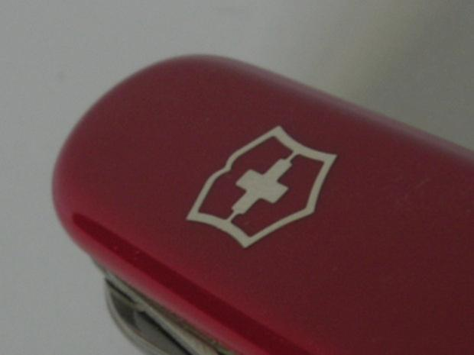
Properties and relations are functions:
inputs (concepts): elements of the domain
output values: elements of the range
color: {tomato,cucumber, lemon,...} → {red,green,yellow,...}
color(tomato)=red
sounds:{(dog,bark),(bird,tweet),(dog,tweet),...} →{true,false}
sounds(dog,bark)=true
sounds(dog,tweet)=false
http://cdn.morguefile.com/imageData/public/files/a/alvimann/preview/fldr_2008_11_07/file0001778635387.jpg
Notes:
12

Slide 13
QUIZ
‘John prefers apples over bananas’.
Interpret this sentence as:
a property of apples
a property of bananas
a property of John
a relation between apples and bananas
a relation between John and apples
a relation between John and bananas.
Notes:
13

Slide 14
Properties and relations can be expressed in many ways
consider the sentence: ‘John prefers apples over bananas’
being preferred over bananas by John is a property of apples with value true
being preferred over bananas by ... is a property of apples with value John
being preferred by John is a relation between apples and bananas with value true
being preferred by ... is a relation between apples and bananas with value John
preferring apples over bananas is a property of John with value true
preferring apples over ... is a property of John with value bananas
being preferred over bananas is a relation between John and apples with value true
being preferred over ... is a relation between John and apples with value bananas
et cetera
Notes:
14

Slide 15
Summary:
words help to segment the world
words refer to entities
entities can be existing or conceived
conceived entities: concepts
properties: inform about a concept
property: name, value
type: collection of values admitted for a property
relation connects concepts
Notes:
15

